Slide 1

Class Project
CSCI 6442
George Washington University
Spring 2014

Slide 2
Agenda
Introduction to the Project—DCR
Data Model – Builder Team
Star Schema Model – Analyzer Team
Project Organization—System Engineering Team
Builder Team
Analyzer Team

Slide 3
Project Introduction
Goals
Use lessons of the course
Data modeling
Transaction processing
Data warehouse
Provide a work-like experience
20 people on one project, not just 3 or 4
Evolving requirements
A demanding customer
High quality UI requirements
Continual testing and evolution

Slide 4
Classroom Software Engineering
High level of communication to all participants
Class email list goes to all project participants
Used for project communications
Activities that are normally serialized can be done in parallel
Data modelling
Use case development
No time to build infrastructure
WordPress provides userids, Web infrastructure
Lots of public documentation, plugins help WordPress development

Slide 5
Why This Application?
Dr. Bill Picon is a clinical psychologist I first met as his patient
He has ideas for what started as a paper questionnaire, evolved through a class project to a custom-built program
This interacts with a patient during an eating impulse
Previous program had everything hard-coded; as ideas evolved it couldn’t be changed easily enough
Basic idea here is to start with a general tool that can handle all the odd things that Bill might want

Slide 6
What It Does
QuestionPeach: a powerful Web-based survey tool
Asks several different types of questions
Collects responses
Can branch to different questions depending on answers
Can present audio, video, URL along with questions and answers
Incorporates powerful analytical tools and report writing for results
Has the ability to take a series of actions connected with a question

Slide 7
A quick demonstration of Questionpeach.com

Slide 8
Systems Engineering Team
Responsibilities
Project Organization
Accomplishments

Slide 9
Timeline
Feb 19 – Mar 25
Form the team
March 26 – April 12
Divide the responsibility
Ashley-Builder
March 26 – April 12
Weekly Meeting with professor to report the progress of the plugin development
Do the research for the WordPress and Plugin
April 12 – April 19
Create the role and capability of the plugin
April 19– April 29
Improve the role and capability
Create OwnerId and EditorId and save their relations to support the role filter implementation
May
Integrate Two plugins
Introduce WP
Chandan-Analyzer
Guide Team members to develop plugin and to use databases
Create the UI for owner to view editors
Give suggestions to both teams
Upload plugins to the test site

Slide 10
Project Organization
System Engineering Team:
Direct the project technical efforts
Test and Confirm the designed project to meet customer requirements
Integrate into a single plugin
Builder Team:
A plugin for users to create, publish and distribute online surveys
Analyzer Team:
A plugin for users to analyze the results of surveys
Independent Testers:
Testing of builder and analyzer plugin development
Unit testing
Integration testing

Slide 11
Accomplishments - Chandan Sharma
Create demo for the whole class on the wordpress plugin describing the whole process involved in creating the plugin
Testing of the software on the Test site
Integration of the plugin
Continuous involved in both the teams to make sure that we are on the right track.
Helped Ashley in migration of the database.
Managed the test and staging sites along with their control panels and database.
Weekly project report and issues discussion with the professor
Designed the UI for the actions.

Slide 12
Accomplishments – Asheesh Banga
Introduce Wordpress and its plugin features in class.
Discuss how the plugin will help us in achieving our goals in an easier way.
Worked with the Builder and the Analyzer teams with respect to how to integrate the two data models.
Integration of the two plugins into a single plugin once the data models were decided upon and the plugins created.
Helped migrate the data from the testing site to the main site.
Regular discussions with the Professor and SET team members regarding the progress and future guidelines.

Slide 13
Accomplishments – Xinyi Zhu
SET
Create WordPress Roles and Capabilities
Develop a UI page for Owners to assign surveys to their survey editors
Builder Team
Implemented:
Insert Query Function
Add the admin menu for the plugin
survey related features:
Creation
Tested and made minor changes
Publishing
Created the URL for each survey
Created the dynamic short code to display the survey
Analyzer Team
Implemented:
Create a setting page for cron job migration and deletion
Develop UI pages to allow users to assign intervals for the specific cron job
Help with modifying the cron functions

Slide 14
Generalized Data Model - SET
OLTP (Online Transaction Processing)
Characterized by a large number of short on-line transactions (Insert, Update and Delete commands)
Main emphasis is a very fast query processing and maintaining data integrity in multi-access environments.
The data model created by the Builder team is a highly normalized model concurring with all rules for normalization up to 4NF.
OLAP (Online Analytical Processing)
Characterized by low volume of transactions.
Involve complex queries compared to OLTP and involve aggregations.
An effective measure for these systems is the response time.
The data model created by Analyzer team uses the Star Schema containing aggregated data.

Slide 15
OLTP—Builder Team Data Model
The entities involved:
gwu_survey
gwu_question
gwu_action
gwu_answerChoice
gwu_response
gwu_flag
gwu_session

Slide 16
OLAP—Analyzer Team Data Model
The entities involved (Star Schema Design)
Fact table
question_response
Dimension tables
question_dim
questionaire_dim
location_dim
time_dim
respondee_dim

Slide 17
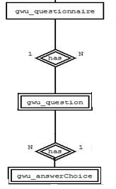
Integration
OLTP
OLAP
questionaire_dim
question_response
question_dim

Slide 18
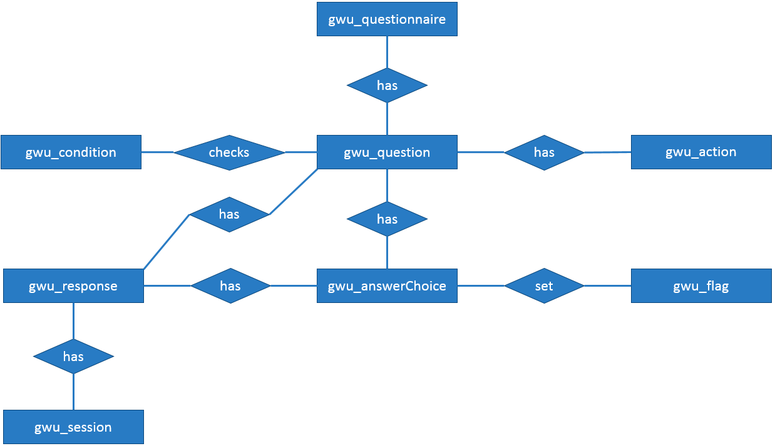
Builder Team Data Model – Chen’s Notation

Slide 19
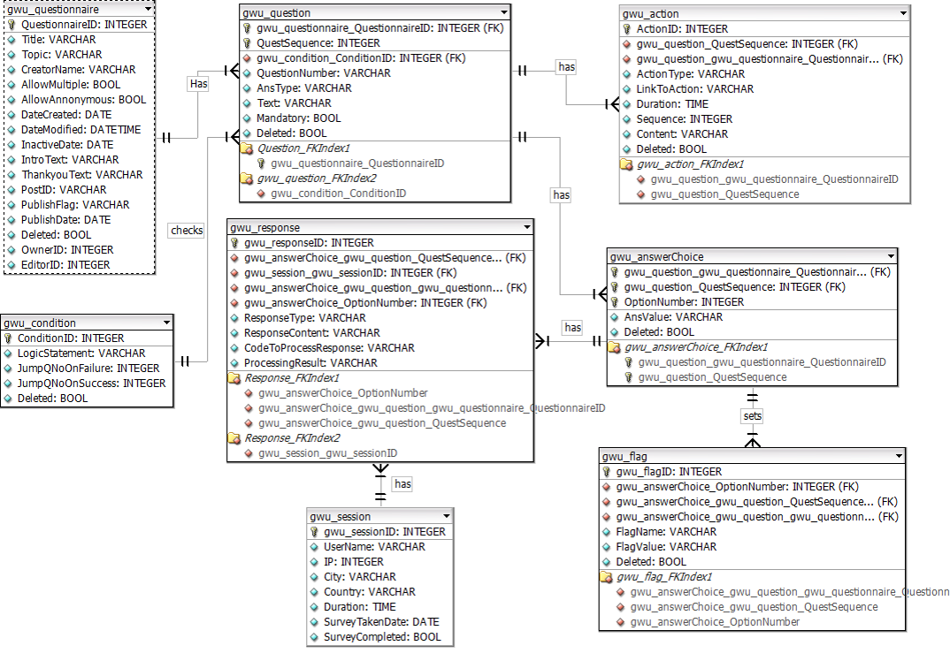
Builder Team Data Model – Crow’s Foot Notation

Slide 20
Normalization and Roberts’s Rules
Normalization:
1NF is followed – All attributes of the entity are atomic
2NF is followed – All the attributes are about the entity
3NF is followed – There are no transitive dependencies
4NF is followed – There are no multi-valued dependency
BCNF is followed – There are no overlapping candidate keys
Roberts’s Rules:
RR1 is followed – All attributes are about the entity
RR2 is followed – No repeated facts
RR3 is followed – Each tuple is present only once
RR4 is followed – No attributes have cardinality greater than 1

Slide 21
Star Schema Data Model – Chen’s Notation
questionnaire_dim
time_dim
question_response
question_dim
location_dim
respondee_dim

Slide 22
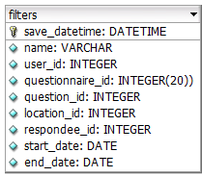
Data Model cont…
filters

Slide 23
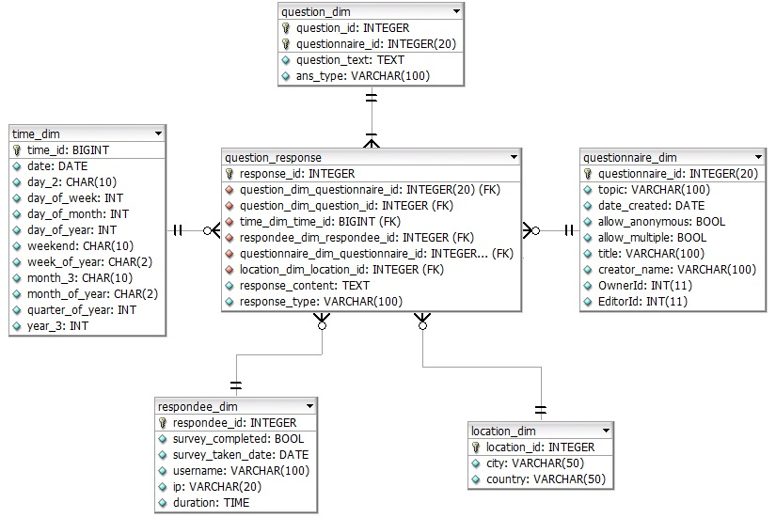
Star Schema Data Model – Crow’s Foot Notation

Slide 24
Normalization in Star Schema?
Normalization:
Star schemas are denormalized, meaning the normal rules of normalization applied to transactional relational databases are relaxed during star schema design and implementation

Slide 25
Builder Team
Responsibilities
Team Organization
Accomplishments

Slide 26
Timeline
March 19 – March 25
Form teams
Choose team leader
March 26 – April 1
Improvised Data Model
Use cases.
April 2 – April 8
Questionnaire creation
Work on the data model.
Develop a plugin that:
Creates tables on installation.
Display tables on page.
April 9 – April 15
Lock the data model.
April 16 – April 29
Update data model to reflect roles.
Condition Creation
May
Testing and recovery.
Deletes tables on uninstallation.
Question creation
ORM
Response Page
Publishing the questionnaire
Flags Creation
Action display
Updated the plugin
Action Creation
Condition Evaluation
Multiple action support
Edit and delete functionality
Questionnaire duplication
Created new theme
Action upload feature

Slide 27
Team Effort
1st Phase
Team as a whole worked on data model.
2nd Phase
Use Cases.
3rd Phase
Database programmers.
Data Model.
Plugin Development.
Plugin programmers.
Testers.
Survey creation development.
Survey taking development.

Slide 28
Software Organization
Survey Creation
Survey Taking
Question and question choice creation
Action creation
Flag creation
Logic and branching creation
Display survey
Record response
Evaluate condition
Action display
ORM
Database
Wrapper

Slide 29
Accomplishments– Mustafa Dasorwala
Responsibilities:
Dividing the tasks among team members
Discussing and resolving issues faced by team
Finalizing implementation logic
Worked on Data Model
Created the ORM
Implemented Action creation functionality
Created survey Duplication functionality
Implemented Condition Parser
Performed White Box Testing

Slide 30
Accomplishments - Nada Alarfag
Worked on the Data model
Created Git repository for the builder plugin
Introduced classes to the plugin and functionalities decoupling
Implemented:
Tables create and drop statements
survey related features:
Creation, Editing, Deletion
Deactivating a published link and republishing
Check current role and view surveys accordingly
Extend WordPress list table to view surveys
Create a template for executing published survey
Hide the list of published surveys from the homepage
Questions related features:
Adding new question, Editing, Deletion
Shift questions’ sequences for question added between questions
Viewing all Questions
Helped in the integration of the builder and analyzer plugin

Slide 31
Accomplishments – Darshan Pandhi
Data Model design and Chen notation diagram
Documented and presented all the use cases for the Builder team
ORM
Researched several open source ORM frameworks for Wordpress like Doctrine, Yi and Wp-ORM
Modified Wp-ORM and added several new features based on the requirements of the plugin
Created models to map all the tables in the database and made a Wrapper class which made it easy for others to interact with the database
Added the feature to define conditions for branching
Helped in
Session creation
Defining actions
General error debugging and solving

Slide 32
Accomplishments—— Kaihua Wu
Developed the Data model
Implemented:
Response.php(use to show survey for user to take, and save their responses)
Session Part: Check anonymity, save unfinished survey, save user basic information
Response Save Part: Save users’ response
Branching Part: Check every question’s logic, decide which question will be next.
Display Action Part: Show the related image and video of a question
Display Question Part: Display question one by one.

Slide 33
Accomplishments– Sachin Telalwar
Responsibilities:
Started with studying project and understanding already implemented application such as survey monkey etc
- Data Model :
Worked on Data Model
- Use case design :
Part of use case designing team
We came up with 9 test cases initially and I wrote 3 use cases and presented it.
- ORM :
I was part of ORM designing team.
Studied ORM like Doctrine, Yii and Wp-ORM. We used Wp-ORM and modified it accordingly our need
We created Wrapper class so that every developer can use ORM functionalities.

Slide 34
Accomplishments– Sachin Telalwar
- Displaying survey from URL :
Given a URL display all question according to their type.
- Saving responses :
Developed a logic to save all the responses given by user.
- Branching :
Get the flag values based on user responses.
Compare the flags with logic statement stored in database
Decide whether they match or not and depending on that display next question
- Unit testing

Slide 35
Accomplishments– Neeraj Ughade
Responsibilities:
- Data Model :
Worked on the Chen’s Notation diagram of Data Model
- Use case design :
I was part of the Use Case designing team
we discussed and implemented 9 use cases, I created 2 use cases
- User Interface :
I was part of the UI designing team.
I created the “Add New survey” page
Designed the UI for the flag creation and set condition
Worked on the UI for Action creation
- Performed Unit Testing

Slide 36
Accomplishments– Sunny Rahl Baba
Responsibilities:
Data Model:
Worked on the chen data model
Use case design:
Part of use case design team and created 9 Use Cases of out which I created 2 Use Case diagram
User Interface:
Part of the UI designing team
Created a php script called “Add a Question” which was used to populate data from the database
Showing an hardcoded image / video from database
36

Slide 37
Accomplishments– Tejasvi Sharma
Responsibilities
Worked on Data Model
Use Case Design:
Part of Use Case Design Team
Total 9 Use Cases
Created 2 Use Cases
Worked on ORM
SQL Scripting & Populating Data in Tables
Worked on UI for Action Creation.

Slide 38
Accomplishments - Monisha
Responsibilities:
Make changes and maintain the data model
Manually populate data in the tables using SQL scripting
Change the corresponding plug-in depending on the changes in the data model
Testing of builder team development
Black-box testing
Unit testing
Integration testing

Slide 39
Analyzer Team
Responsibilities
Team Organization
Software organization

Slide 40
Responsibilities
Star schema.
Use cases.
Create a plugin.
Create and drop tables.
A cron job that migrates data.
Design a GUI query tool.
Graphical representation of results.
Generate reports.
Export reports to PDF.
Integration with builder’s plugin.

Slide 41
Timeline
March 19 – March 25
Form teams
Choose team leader
March 26 – April 1
Star schema data model.
Use cases.
April 2 – April 8
A transfer code (data migration).
Cron job to transfer data.
Work on the data model.
Develop a plugin that:
Creates tables on installation.
Display tables on page.
Design a GUI query tool.
April 9 – April 15
Lock the data model.
A single plugin that does all the functionalities.
Produce analytical report.
Produce graphical results.
April 16 – April 29
Update data model to reflect roles.
Customized Reports using filters.
Net Score Promoters surveys.
May
Testing and recovery.
Deletes tables on uninstallation.
Export to PDF.

Slide 42
Team Effort
1st Phase
Team as a whole worked on data model.
2nd Phase
Use Cases.
3rd Phase
Database programmers.
Star Schema Data Model.
Plugin Development.
Plugin programmers.
Testers.
GUI designers.

Slide 43
Software Organization
Analyzer
GUI
View graphical results
Behind The Scene
Create tables
Data migration
Create filters
Cron job
Drop tables
Export reports as PDFs
Generate analytical reports based on filters

Slide 44
Individuals and Responsibilities
Iswarya Parupudi
Use cases
GUI Design
Yash Shah
Hrishikesh Sadar
Use cases
Cron job
Data model
Testing
Testing
GUI Map & Charts
GUI Map & Charts
Testing
Kholood Alnowaiser
Team leader
Data model
Data migration
Filters Implementation
GUI Design

Slide 45
Individuals and Responsibilities
Sonal Sonavane
Use Cases
Ibou Diallo
Plugin creation
Alemberhan Getahun
Plugin creation
Filters Implementation
GUI implementation
Cron Job
(Back Up)
Export to PDF
Data Migration script
Cron job
Filters Implementation
Data Migration
Harsh Shah
GUI design
Use cases
Testing on Cron job

Slide 46
Accomplishments - Kholood Alnowaiser
Team leader
Divide the job
Be there for other team members
Learn from mistakes!
Data model and star schema
Data migration functions for
First installation
Cron job
Refresh button
Data integration with builder’s tables
SQL scripts
Custom reports algorithm and UI design for filters

Slide 47
Accomplishments - Hrishikesh Sardar
Developed the star schema data model
Contributed in the GUI Code for implementing Google Charts and Geo Map
Testing of analyzer team development
Black box Testing
Unit testing
Integration testing

Slide 48
Accomplishments - Yash Shah
Cron Job
Research about Cron job, implement and test on the test and staging site with one plug-in
2 Cron Job have been implemented
Data Migration
Data Deletion
Use Cases
Designed the use case according to the requirements the project
5 sets of Use cases having 3 versions
Contributed in Designing the GUI of the analyzer plug-in
Unit Testing of analyzer team development
Cron Job
Filter
Team Meeting and classroom project Discussion

Slide 49
Accomplishments - Harsh Shah
Worked on the data model
Use Cases:
Developed a set of use cases for analysis of survey results
Updated the 3 use case versions along the lifecycle of the project
GUI of the Analyzer page:
Developed the final GUI for the analyzer plugin
Helped other team member in the implementation of various modules
Testing:
Performed Unit Testing on filters

Slide 50
Accomplishments - Sonal Sonavane
Use Case Design
I have participated in Use-Case design and creation
Cron-Job (Back –up )
I also worked on cron-job , where I researched & built alternative solution for the cron-job.
Export survey as PDF
I worked on this UI feature of exporting survey as PDF
Resolving Issues
I also helped to resolve issues experienced by debugging and testing .

Slide 51
Accomplishments - Alemberhan Getahun
Plug-in Design and implementation
Develop the User Interface(UI) for Analyzer
Implement all the functionalities
Populating dimension tables values from the database
View All result
Save filter
Manage Filter
Refresh
Authorization and authentication
result presentation ( graph, pi-chart (NPS) and text)

Slide 52
Accomplishments - Ibou Diallo
Plugin Design and implementation
Developed initial plugin utilities including data migration and cron job and UI utilities
Merge plugins
Implement the following functionalities
Scheduled Cron job for data migration
Data migration utilities (Create table, drop table, insert data functions, SQL scripts)
Save filter
Manage Filter
Data output presentation (NPS design)

Slide 53
Accomplishments - Iswarya Parupudi
Developed a set of use cases for analysis of survey results
Designed the GUI of the analyzer plug-in
Contributed in the GUI Code for implementing Google Charts and Geo Map
Testing of analyzer team plug-in
Black box Testing
Unit testing
Integration testing

Slide 54
QuestionPeach V 2.0
Builder Team:
Import/Export survey
Adding Duration to Actions
Additional Question Types
Magic Button for NPS Questions
Custom Logo
Advanced Logic Functionality
Analyzer Team:
Change from functional design to a modular design – MVC
Implement additional media format to represent data – Pictures and Videos
More rigorous exception handling to promote a “golden copy of data”
Implement additional graphical representation of the result - Graphs

Slide 55
Thanks!

